Slide 1







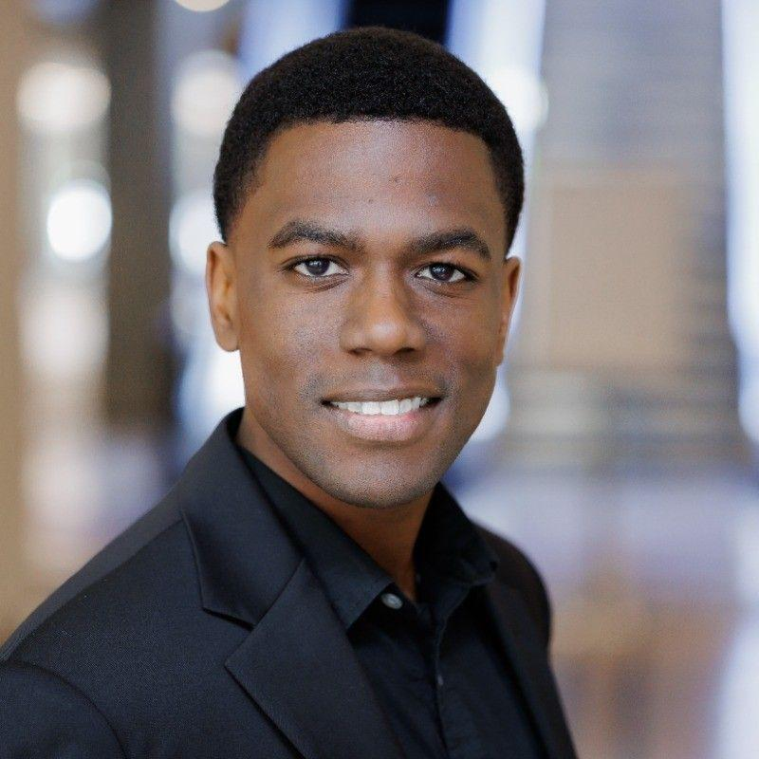
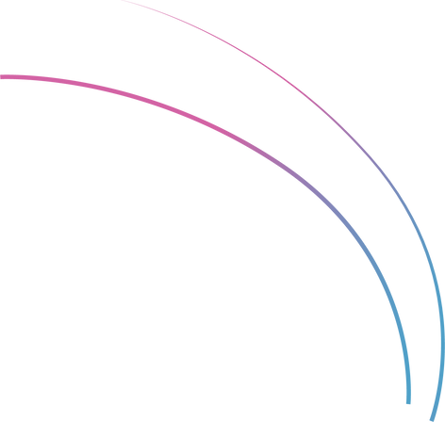
WORKSHOPS
Building Interactive Machine Learning Apps with Gradio
Daryle Serrant
Data Scientist & ML Consultant
byteSolid Solutions

Slide 2
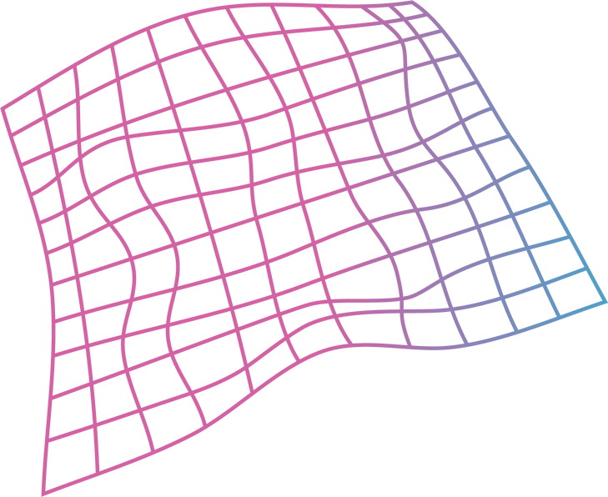
daryleserrant.com
github.com/daryleserrant
About the Instructor
Studied CS at Florida Institute of Technology
Data Scientist/SW Engineer at Tesla, Lockheed Martin, background in Aerospace, Consumer Electronics, Health & Wellness, and Renewable Energy
Daryle
Serrant
byteSolid Solutions
Data Analytics: Analyze data, produce reports and conclusions, and identify AI/ML use cases
AI/Machine Learning: Develop AI/ML solutions that bring value to a business
Software Development: Includes web development and Mobile (iOS/Android) app development
Technical Training: 1-on-1 or group technical training to individuals and groups
Data Scientist
&
ML Consultant

Slide 3
During this workshop you will…
1
Master Gradio Fundamentals
2
Create Interactive ML Interfaces
3
Implement Advanced Features like State Management and Custom Styling
4
Integrate Gradio with ML Models
Notes:
By the end of this workshop, you will:
Master Gradio Fundamentals: Understand the core concepts and uses of Gradio for machine learning interfaces.
Create Interactive ML Interfaces: Learn to build interactive web interfaces for ML models using Gradio.
Implement Advanced Features: Explore advanced Gradio functionalities like state management and custom styling.
Integrate Gradio with ML Models: Gain practical experience in integrating Gradio with different types of machine learning models.

Slide 4
Table of Contents / Agenda
1
Tech Overview [20 Minutes]
2
Hands-on Practice [20 Minutes]
3
Final Quiz

Slide 5
Prerequisites
1
Basic knowledge of Python
2
Familiarity with Google Colab or Jupyter notebook
3
Basic knowledge of machine learning concepts and algorithm

Slide 6


Tech Overview

Slide 7
Importance of UI in ML Models
Accessibility
Interactive Data Exploration
Transparency and Trust
Feedback for Improvement
Democratization of ML
Real-world Integration
Collaboration Enhancement
Educational Tool
Notes:
Tech Overview
The Importance of User Interfaces in ML Models
Accessibility
Interactive Data Exploration
Transparency and Trust
Feedback for Improvement
Democratization of ML
Real-world Integration
Collaboration Enhancement
Educational Tool

Slide 8
Common UI Building Challenges
Simplifying model outputs for understanding.
Balancing advanced features with user-friendly interfaces.
Designing for diverse expertise and abilities.
Feedback loop integration
Cost and resource optimization
Notes:
Common Challenges in Building UI for ML Models
Complexity Management: Simplifying ML model outputs for user understanding.
Interactive Design: Balancing advanced features with user-friendly interfaces.
User Accessibility: Designing for diverse expertise and abilities.
Feedback Loop Integration: Incorporating user feedback for model and UI improvements.
Cost and Resource Optimization: Managing efficient UI design within resource constraints.

Slide 9
Introducing Gradio
Open-source framework for ML application interfaces
Instantly share a web link to your app without web hosting
Excellent for:
PoC development
Demonstrations
Collaborative development
Notes:
Introducing Gradio
Gradio is an open-source Python framework that can help you easily create interfaces for your machine learning applications without needing to know any HTML, CSS, or Javascript.
One of the key features of Gradio is its ability to instantly share a web link to your app so that anyone in the world can view it without the need for web hosting. This makes Gradio an excellent tool for:
Rapid proof of concept development
Educational demonstrations
Collaborative machine learning development

Slide 10
Demonstration time!
http://tinyurl.com/ZSL-gradio

Slide 11
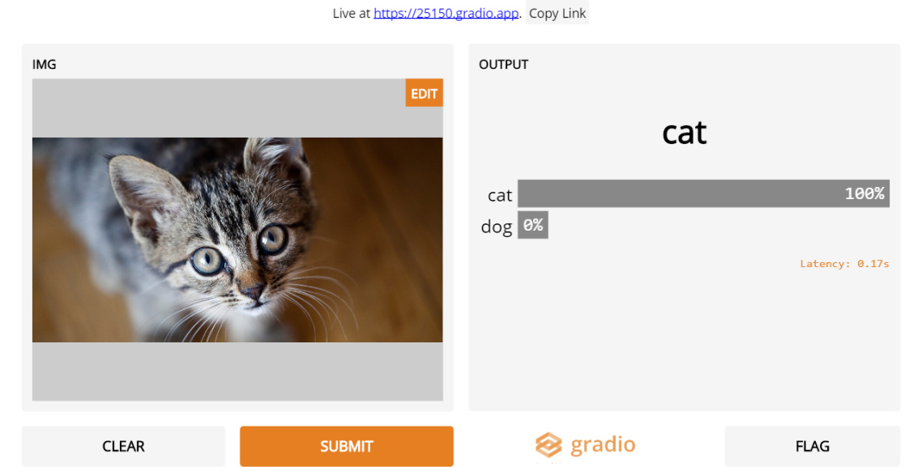
Demo
Core Features of Gradio
Gradio simplifies the creation of machine learning interfaces by breaking them down into three main components:
Input components
Output components
Interface Class
Understanding these features is key to effectively using Gradio.
Insert Image Here

Slide 12
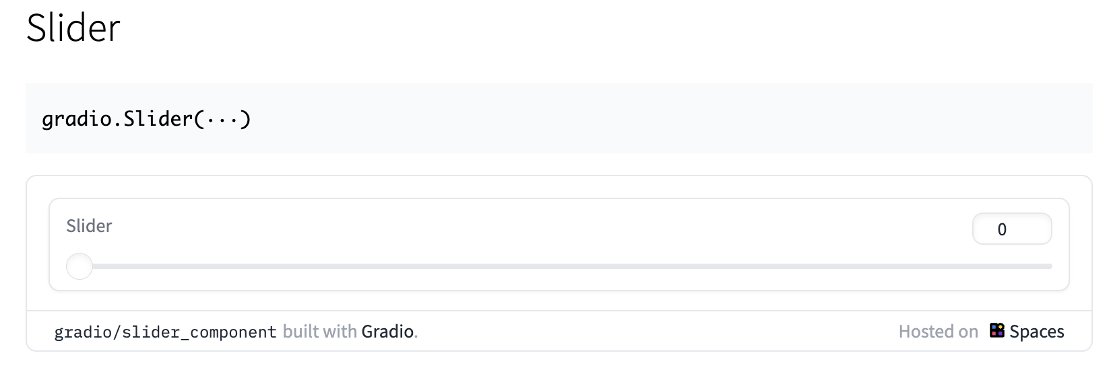
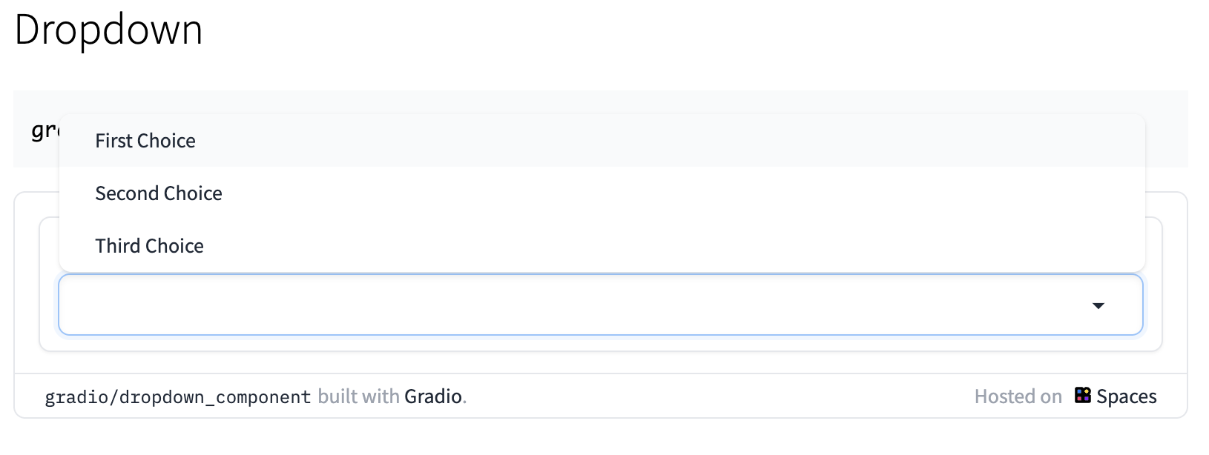
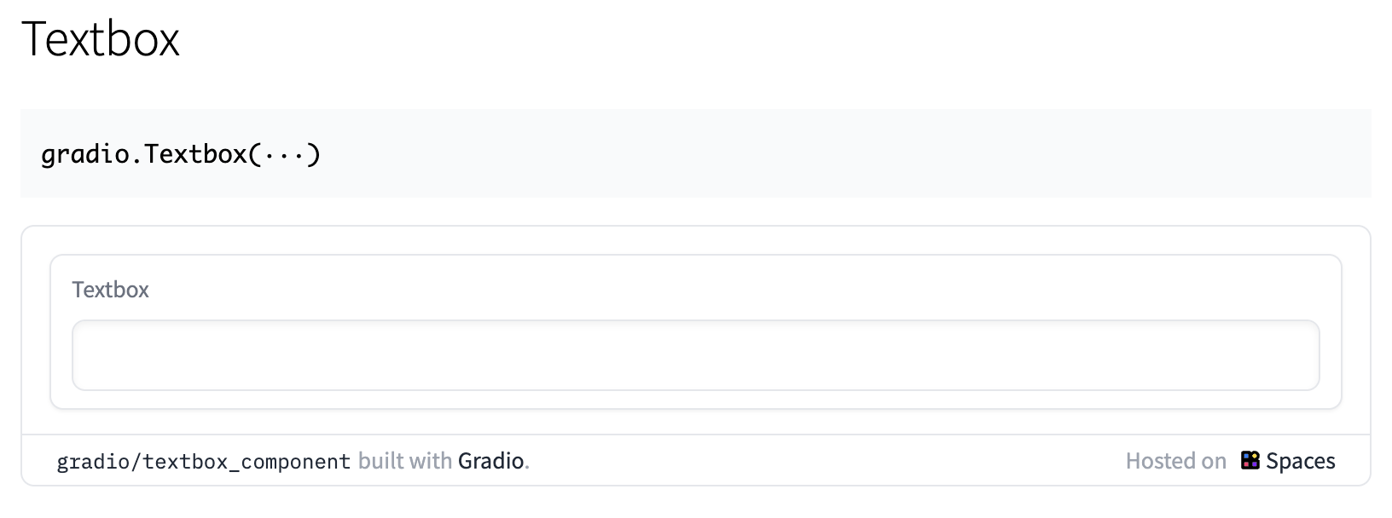
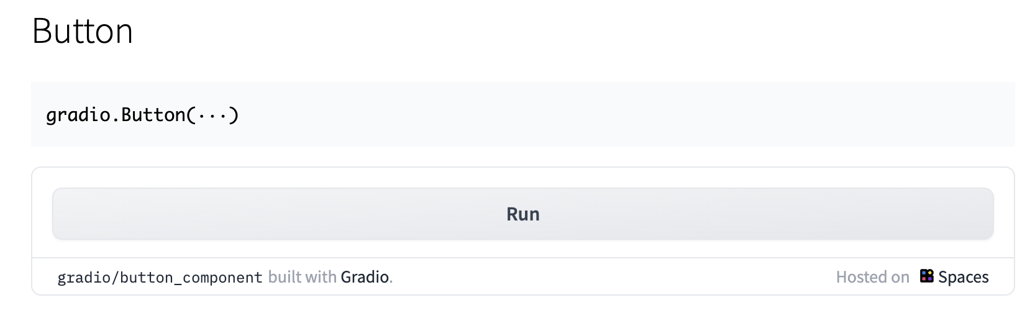
Building a Simple Gradio Interface
Gradio makes it easy to add interactive elements to your machine learning interfaces. These elements can significantly enhance user experience by allowing users to interact with your models in a dynamic way. Let's explore how to incorporate common interactive elements like sliders, dropdowns, and buttons into a Gradio interface.
Insert Image Here

Slide 13
Enlarged image from previous slide
WORKSHOPS

Slide 14
Demo
Effective Layout and Design in Gradio Interfaces
Effective layout and design are crucial in creating Gradio interfaces that offer an intuitive user experience and clear presentation of results. Here’s how you can arrange elements in Gradio to achieve this:
Understand Gradio’s Layout Options
Design an Intuitive Interface
Insert Image Here

Slide 15
Demo
Create a Gradio Interface with the Interface class
The gradio interface class has three required parameters:
fn = represents the function that you want to create the interface for.
inputs = selected input components. If this is set to None, then only the output components will be displayed.
outputs = selected output components. If this is set to None, the only the input components will be displayed.
N.B. The number of inputs MUST be equal to the number of outputs
Insert Image Here

Slide 16
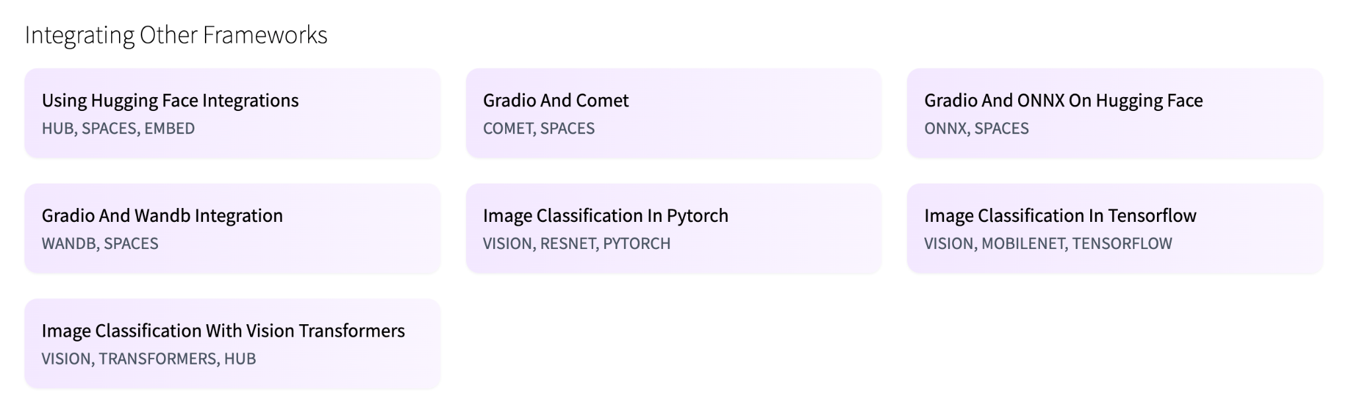
Demo
Integrating ML Models with Gradio
Gradio can also integrate various types of machine learning models. Let's create examples that demonstrate how to connect a simple machine learning model from scikit-learn, a TensorFlow neural network model, and a PyTorch model with a Gradio interface in the following slides…
Insert Image Here

Slide 17
Hands-on Practice

Slide 18
Final Assignment
Your final assignment will be to build a Gradio interface that allows users to upload an image, apply transformations (like rotation or color inversion), and then classify the image using a pre-trained model. We will follow these steps:
Set Up the Environment: Install necessary libraries (Gradio, TensorFlow, PIL for image processing).
Load a Pre-Trained Model: Use TensorFlow to load a pre-trained image classification model (like MobileNetV2).
Define Preprocessing Functions: Write functions to apply image transformations (rotation, inversion).
Build the Gradio Interface: Set up interactive elements for image upload and transformations.
Display the processed image and classification results.
Launch and Test the App: Ensure the app handles different image inputs and transformation parameters.
Insert Image Here

Slide 19
Copy this Google Colab and fill in your solution:
http://tinyurl.com/zsl-gradio-final-assignment

Slide 20
Final Quiz

Slide 21
Final Quiz - Q1
What is Gradio primarily used for?
A. Data encryption
B. Web scraping
C. Creating machine learning interfaces
D. Cloud computing
E. 3D Modeling

Slide 22
Final Quiz - Q1
What is Gradio primarily used for?
A. Data encryption
B. Web scraping
C. Creating machine learning interfaces
D. Cloud computing
E. 3D Modeling

Slide 23
Final Quiz - Q2
Which of the following can be integrated as an input component in a Gradio interface?
A. Slider
B. Checkbox
C. Textbox
D. Image upload
E. All of the above

Slide 24
Final Quiz - Q2
Which of the following can be integrated as an input component in a Gradio interface?
A. Slider
B. Checkbox
C. Textbox
D. Image upload
E. All of the above

Slide 25
Final Quiz - Q3
How can you share a Gradio interface with others?
A. Through a unique URL
B. Via email attachment
C. Uploading to a cloud server
D. Through social media
E. QR code

Slide 26
Final Quiz - Q3
How can you share a Gradio interface with others?
A. Through a unique URL
B. Via email attachment
C. Uploading to a cloud server
D. Through social media
E. QR code

Slide 27
Final Quiz - Q4
Which machine learning frameworks can Gradio work with?
A. TensorFlow
B. PyTorch
C. Scikit-learn
D. Keras
E. All of the above

Slide 28
Final Quiz - Q4
Which machine learning frameworks can Gradio work with?
A. TensorFlow
B. PyTorch
C. Scikit-learn
D. Keras
E. All of the above

Slide 29
Final Quiz - Q5
What is a unique feature of Gradio interfaces?
A. Real-time data analysis
B. Automatic model inference
C. Custom HTML/CSS styling
D. Live editing of source code
E. 3D visualization support

Slide 30
Final Quiz - Q5
What is a unique feature of Gradio interfaces?
A. Real-time data analysis
B. Automatic model inference
C. Custom HTML/CSS styling
D. Live editing of source code
E. 3D visualization support

Slide 31
Final Quiz - Q6
Gradio is particularly useful for:
A. Developing mobile applications
B. Conducting user experience research
C. Debugging backend code
D. Demystifying machine learning model outputs
E. Managing databases

Slide 32
Final Quiz - Q6
Gradio is particularly useful for:
A. Developing mobile applications
B. Conducting user experience research
C. Debugging backend code
D. Demystifying machine learning model outputs
E. Managing databases

Slide 33
Final Quiz - Q7
Which of these is NOT a typical use case for Gradio?
A. Image classification demonstration
B. Text generation preview
C. Interactive data visualization
D. Real-time video processing
E. Video game development

Slide 34
Final Quiz - Q7
Which of these is NOT a typical use case for Gradio?
A. Image classification demonstration
B. Text generation preview
C. Interactive data visualization
D. Real-time video processing
E. Video game development

Slide 35
Final Quiz - Q8
How can you improve the performance of a Gradio interface?
A. By increasing the server bandwidth
B. Using smaller data files
C. Optimizing the machine learning model
D. Reducing the number of interface components
E. All of the above

Slide 36
Final Quiz - Q8
How can you improve the performance of a Gradio interface?
A. By increasing the server bandwidth
B. Using smaller data files
C. Optimizing the machine learning model
D. Reducing the number of interface components
E. All of the above

Slide 37
Final Quiz - Q9
In Gradio, what is the purpose of 'Blocks'?
A. To encrypt data
B. To build more complex and customizable interfaces
C. To increase processing speed
D. To store large datasets
E. To create 3D models

Slide 38
Final Quiz - Q9
In Gradio, what is the purpose of 'Blocks'?
A. To encrypt data
B. To build more complex and customizable interfaces
C. To increase processing speed
D. To store large datasets
E. To create 3D models

Slide 39
Final Quiz - Q10
What type of applications can benefit the most from Gradio interfaces?
A. E-commerce websites
B. Machine learning and AI applications
C. Online gaming platforms
D. Social media platforms
E. Financial analysis tools

Slide 40
Final Quiz - Q10
What type of applications can benefit the most from Gradio interfaces?
A. E-commerce websites
B. Machine learning and AI applications
C. Online gaming platforms
D. Social media platforms
E. Financial analysis tools

Slide 41
Wrap-up and Q&A
paul@zeroshotlabs.com

Slide 42
Sources
Official Gradio Documentation: Comprehensive guide and reference for all Gradio functionalities.
Gradio GitHub Repository: Access the source code, examples, and community contributions.
Tutorials and Articles: A collection of articles and tutorials on various Gradio use cases. Additionally, search for Gradio articles on Towards Data Science for practical insights and tips.
Online Courses and Videos: Watch tutorials and project showcases on Gradio YouTube Channel.
DeepLearning.AI TensorFlow Specialization: For understanding TensorFlow in-depth.
Deep Neural Networks with Pytorch: For understanding PyTorch in-depth.
Gradio on Hugging Face: Share your Gradio projects, interact and collaborate with other Gradio users.
Insert Image Here

Slide 43
Thank You!
paul@zeroshotlabs.com

